Slide 1
Building Docker Images
Based on the Fundamentals of Docker course by Docker Inc.

Slide 2
Initial preparation
Create a fork of https://github.com/linhbngo/cluster-template in your Github repository
Follow the instructions from Programmatic Deployment on CloudLab to create a new CloudLab profile called Docker.
Do not instantiate from master branch. Instead, after finishing set up the webhook, go back and instantiate from the docker branch of the profile (see screenshot on next slide).

Slide 3
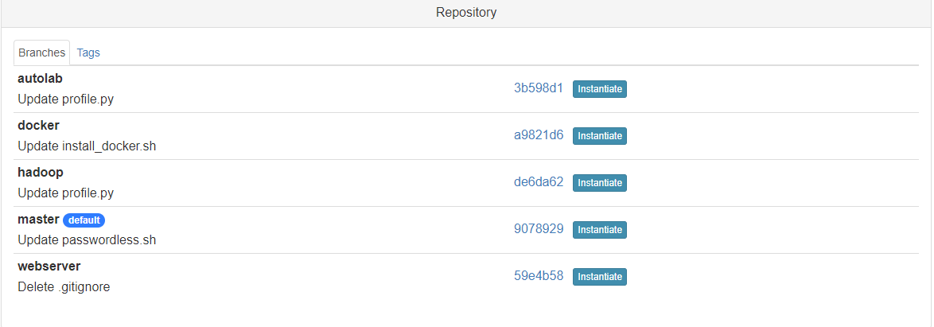

Slide 4
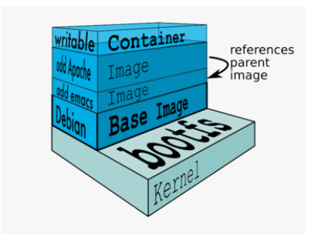
Recall: Images and Layers

Slide 5
Interactive Image Construction

Slide 6
General steps
Create a container using an appropriate base distro
Inside the container, install and setup the necessary software
Review the changes in the container
Turn the container into a new image
Tag the image

Slide 7
Create a container with a base distro
$ docker run -it ubuntu

Slide 8
Install software
# apt-get update
# apt-get install -y figlet
# exit
Note your CONTAINER ID. In this slide deck, it is 5c4ac5316d5

Slide 9
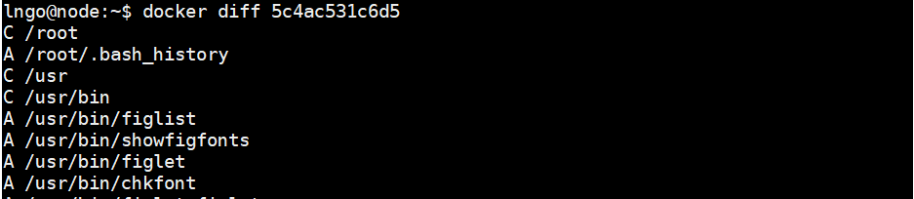
Check for differences
$ docker diff 5c4ac531c6d5
A: A file or directory was added
D: A file or directory was deleted
C: A file or directory was changed

Slide 10
Commit changes into a new image
$ docker commit 5c4ac531c6d5 ubuntu_figlet

Slide 11
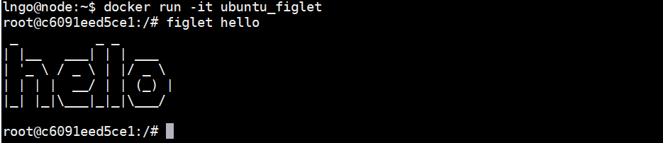
Test your new image
$ docker run -it ubuntu_figlet
# figlet hello

Slide 12
Automatic Image Construction using Dockerfile

Slide 13
What is a Dockerfile
A build recipe for a Docker image
Contains a series of instructions telling Docker how an image is to be constructed
The docker build command builds an image from a Dockerfile

Slide 14
Writing the first Dockerfile
Create a directory to hold the Dockerfile
$ mkdir myimage
Create a Dockerfile inside this directory
$ cd myimage
$ nano Dockerfile

Slide 15
Type the following contents into the nano editor
FROM ubuntu
RUN apt-get update
RUN apt-get install -y figlet
FROM indicates the base image for the build
RUN will be execute by Docker during the build
RUN commands must be non-interactive
Type Ctrl-X and then Enter to save and quit nano

Slide 16
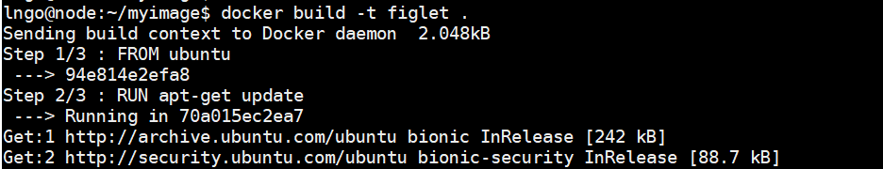
Build the image
$ docker build -t figlet .
-t indicates the tag to apply to the image
. indicates the location of the build context (Dockerfile)

Slide 17
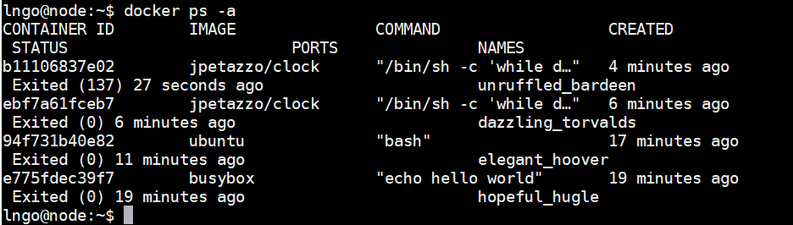
View history of running containers
$ docker ps -a

Slide 18


What has happened?
The build context is the . directory and is sent to the Docker daemon. This context allows constructions of images with additional resources from local files inside the build context.
The base image is setup.
For each RUN, a container is created from the base image for the execution of the commands. Afterward, the resulting container is committed into an image that becomes the base for the next RUN.

Slide 19
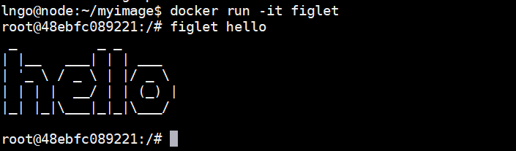
Test the new image

Slide 20
Viewing history of an image
The docker history <tag> lists all layers of an image.
It shows creation time, size, and creation command.
In Dockerfile, each layer corresponds to a line of the Docker file.

Slide 21
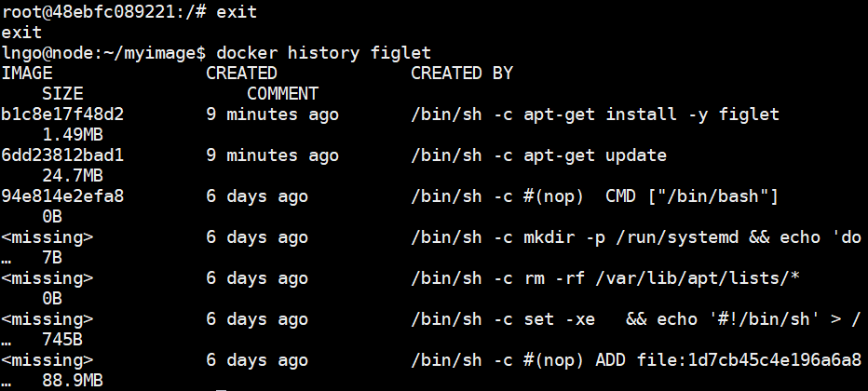

Slide 22
CMD
CMD defines a default command to run when none is given.
It can appear at any point in the file.
There can be only one CMD.

Slide 23
Adding CMD to Dockerfile
Edit the Dockerfile so that it has the following contents:
FROM ubuntu
RUN apt-get update
RUN [“apt-get”,”install”,”-y”,”figlet”]
CMD figlet -f script hello
Rebuild the image
What happens when you execute docker run figlet
We are moving toward how the entire container can behave like a process

Slide 24
Overriding CMD
With CMD, the -it does not behave as expected without a parameter
$ docker run -it figlet
We need to provide a command to override CMD
$ docker run -it figlet bash

Slide 25
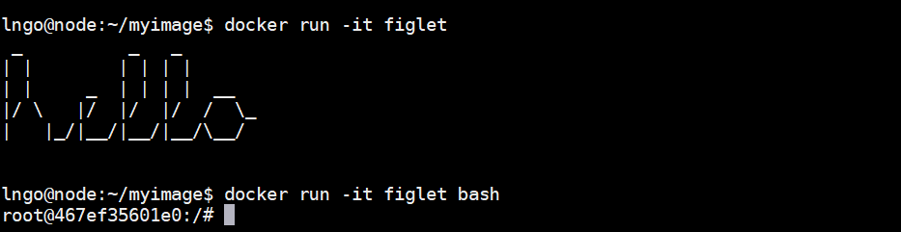

Slide 26
ENTRYPOINT
ENTRYPOINT defines a base command (and its parameters) for the container.
The command line arguments are appended to those parameters.

Slide 27
Adding ENTRYPOINT to Dockerfile
Edit the Dockerfile so that it has the following contents:
FROM ubuntu
RUN apt-get update
RUN [“apt-get”,”install”,”-y”,”figlet”]
ENTRYPOINT [“figlet”,”-f”, “script”]
Rebuild the image
What happens when you execute docker run figlet golden ram
We are moving toward how the entire container can behave like a process

Slide 28
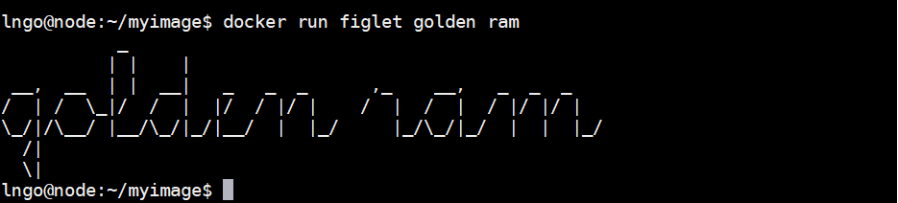
ENTRYPOINT

Slide 29
Why not both
Edit the Dockerfile so that it has the following contents:
FROM ubuntu
RUN apt-get update
RUN [“apt-get”,”install”,”-y”,”figlet”]
ENTRYPOINT [“figlet”,”-f”, “script”]
CMD [“hello rammies”]
Rebuild the image
What happens when you execute docker run figlet golden ram and then docker run figlet
We are moving toward how the entire container can behave like a process

Slide 30
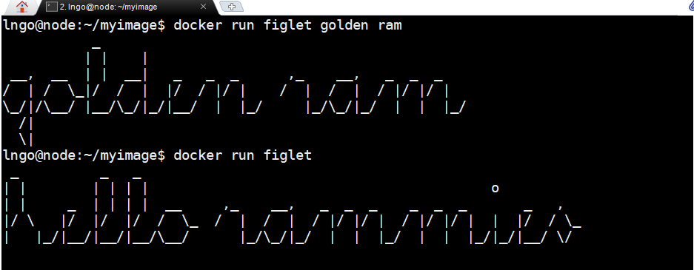
CMD and ENTRYPOINT

Slide 31
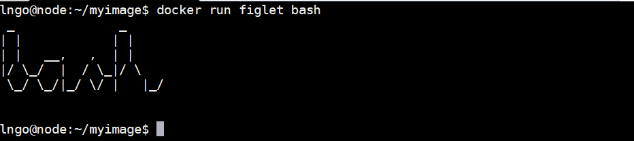
Caveat

Slide 32
Caveat
We need to do it differently
$ docker run -it --entrypoint bash figlet

Slide 33
Docker and Cloud
Highly portable
Consistent across platforms
Next: complex Docker builds with additional files from build context

Slide 34
Build some external C code
Run the following commands
$ cd
$ mkdir myprogram
$ cd myprogram

Slide 35
Build some external C codes
Inside the myprogram directory, create a hello.c file with the following contents:
#include <stdio.h>
int main() {
printf(“Hello, world!”);
return 0;
}

Slide 36
Dockerfile
Create a Dockerfile with the following contents
FROM ubuntu
RUN apt-get update
RUN apt-get install -y build-essential
COPY hello.c /
RUN make hello
CMD /hello

Slide 37
Build Dockerfile
$ docker build -t hello .
$ docker run hello

Slide 38
Upload the images to the Docker Hub
Create an account on Docker Hub:
https://hub.docker.com/
Run
$ docker push <user_name>/<image_name>

Slide 39
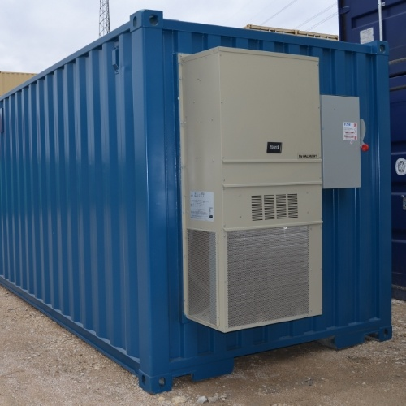
Networking for Docker
How can services provided by a container become available to the world?

Slide 40
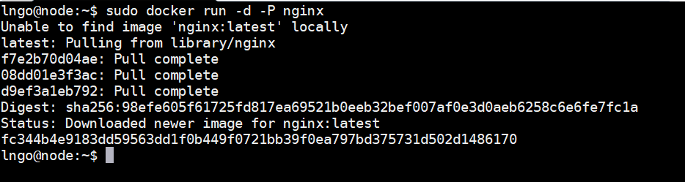
A simple web server
$ sudo docker run -d -P nginx
-P: Make this service reachable from other computers ( --publish-all )

Slide 41
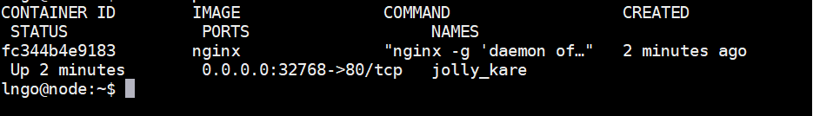
Where is the port?
$ docker ps
$ ip addr | grep /22

Slide 42
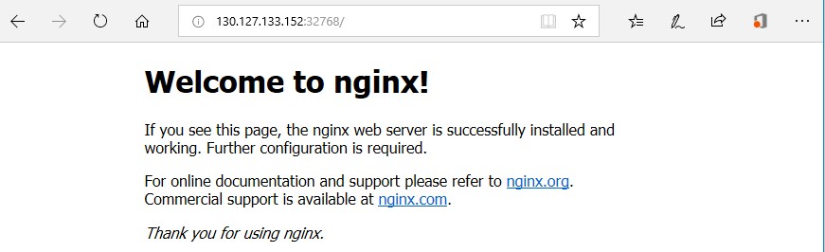

Slide 43
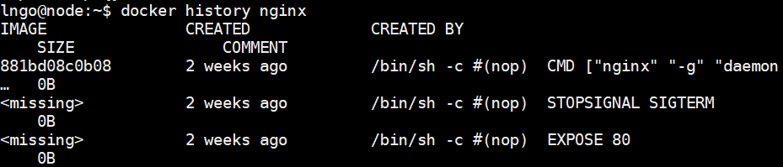
How does Docker know which port to map?
This is described in the Dockerfile by the developed.
The keyword for this action is EXPOSE

Slide 44
Why do we have to map ports?
Containers cannot have public IPv4 addresses.
We are running low on IPv4 addresses anyway.
Internally to host, containers have their own private addresses
Services have to be exposed port by port.
These have to be mapped to avoid conflicts.

Slide 45
Manual allocation of port numbers
$ docker run -d -p 80:80 nginx
$ docker run -d -p 8000:80 nginx
$ docker run -d -p 8080:80 -p 8888:80 nginx
Convention: port-on-host:port-on-container
Check out the web servers at all of these ports on your CloudLab node

Slide 46
How to integrate containers into your infrastructure
Manually add the containers to the infrastructure via Docker-generated public port.
Predetermine a port on the infrastructure, then set the corresponding port mapping when run the containers.
Use a network plugin to connect the containers with network tunnels/VLANS …
Enable Docker Swarm Mode to deploy across a physical cluster.

Slide 47
Docker’s Container Network Model
Introduced in Engine version 1.9.0 (November 2015)
Provide the notion of a network to connect containers
Provide top level command to manipulate and observe these networks: docker network

Slide 48
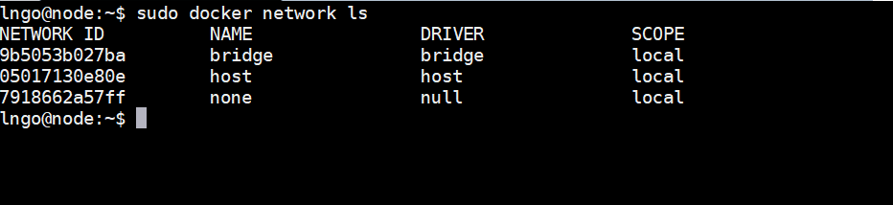

Slide 49
What’s in a docker network?
Conceptually, it is a virtual switch
It can be local to a single Engine (on a single host) or global (spanning multiple hosts).
It has an associated IP subnet.
Docker will allocate IP addresses to the containers connected to a network.
Containers can be connected to multiple networks.
Containers can be given per-network names and aliases.
The name and aliases can be resolved via an embedded DNS server.

Slide 50
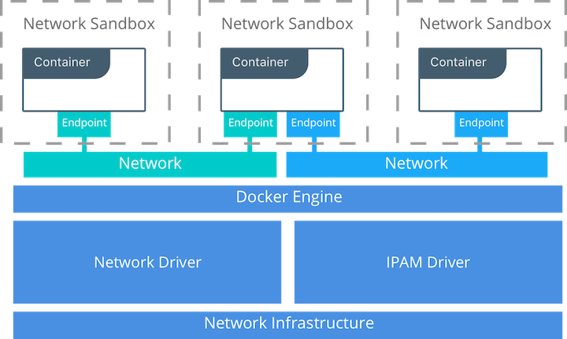

Slide 51
Network implementation details
A network is managed by a driver.
Built-in drivers include:
bridge: create a private network internal to host so containers on this network can communicate.
host: the container uses the networking stack of the host, including all interfaces.
none: the container is completely isolated from the host networking stack
macvlan: this is used to provide routable (public) IP addresses to containers through host network interfaces.
overlay: creates an overlay network that supports multi-host networks out of the box to allow container-to-container communications over physical network infrastructure.

Slide 52
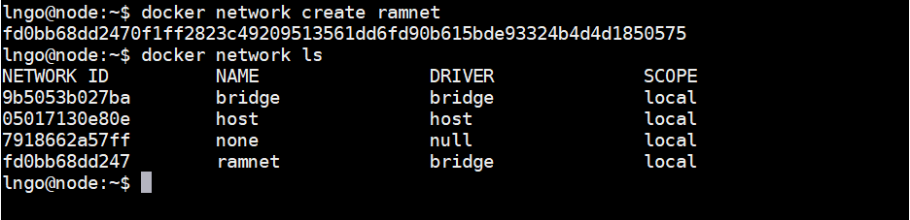
Create a network
$ docker network create ramnet
$ docker network ls

Slide 53
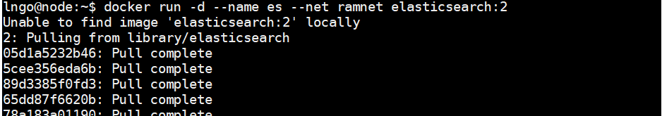
Placing containers on a network
We are going to run a background container with a name
$ docker run -d --name es --net ramnet elasticsearch:2

Slide 54
Communication between containers
Let’s create another container
$ docker run -ti --net ramnet alpine sh
# ping es
What do you see?

Slide 55
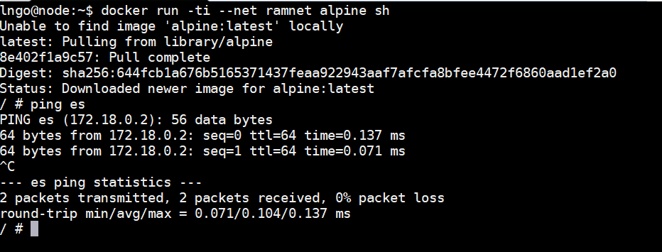

Slide 56
Service discovery with containers
Run an application with two containers.
First container is a web server.
Second container is a redis data store.
Both will be placed on ramnet

Slide 57
Running the web server
$ docker run --net ramnet -d -P jpetazzo/trainingwheels
$ docker ps -l

Slide 58
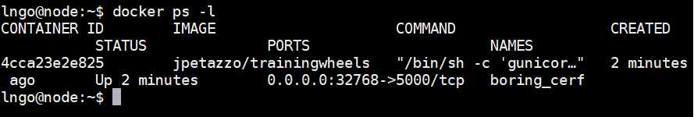

Slide 59
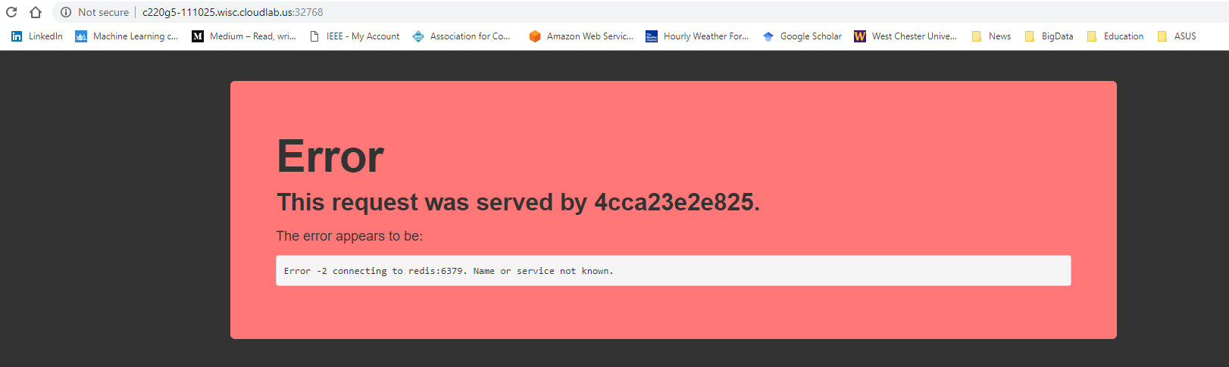
<your_cloudlab_hostname>:32768

Slide 60
Running the Redis server
$ docker run --net ramnet --net-alias redis -d redis
$ docker ps

Slide 61
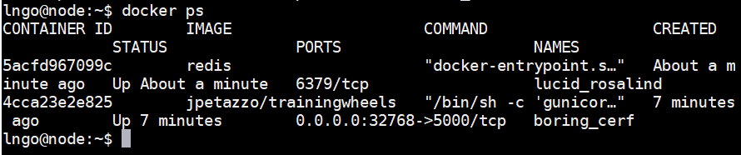

Slide 62
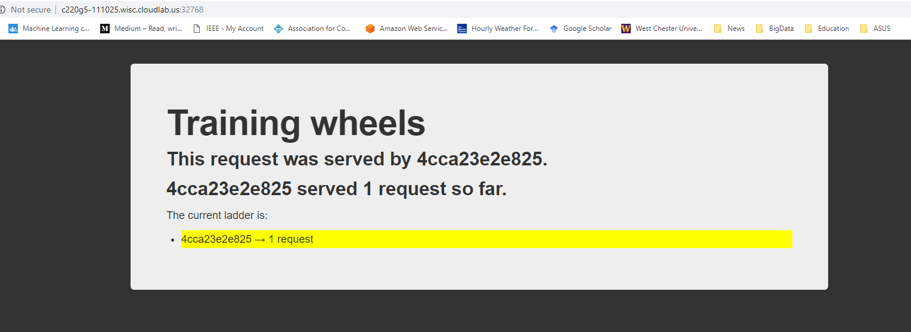
<your_cloudlab_hostname>:32768

Slide 63
Docker Compose

Slide 64
Why Docker Compose?
Dockerfiles are great for building container images.
Dockerfiles are not quite satisfactory if you have to link multiple containers into a complex infrastructure.
We want the ability to write custom scripts (program everything!) to automatically build, run, and connect containers together.
This is possible via Docker Compose

Slide 65
Docker Compose in nutshell
External, Python-based tool.
Open source.
Simple deployment workflow
Checkout code
Run docker-compose up
Everything is up and running!

Slide 66
Overview of Compose
Design of a container stack is described in a YAML file called docker-compose.yml.
Run docker-compose up.
Compose automatically pulls images, builds containers, and starts them.
Compose can
Set up links, volumes, and other Docker options for the container stack.
Run containers in the background or in the foreground.

Slide 67

Check for Docker Compose
$ docker-compose --version

Slide 68
Exercise
Before we start a Docker Compose exercise, completely remove the two containers and its corresponding images from the previous example.
You can use the following commands
docker image ls
docker container ls
docker container rm
docker image rm

Slide 69
Run the following commands
$ cd
$ git clone https://github.com/jpetazzo/trainingwheels
$ cd trainingwheels/
$ docker-compose up

Slide 70
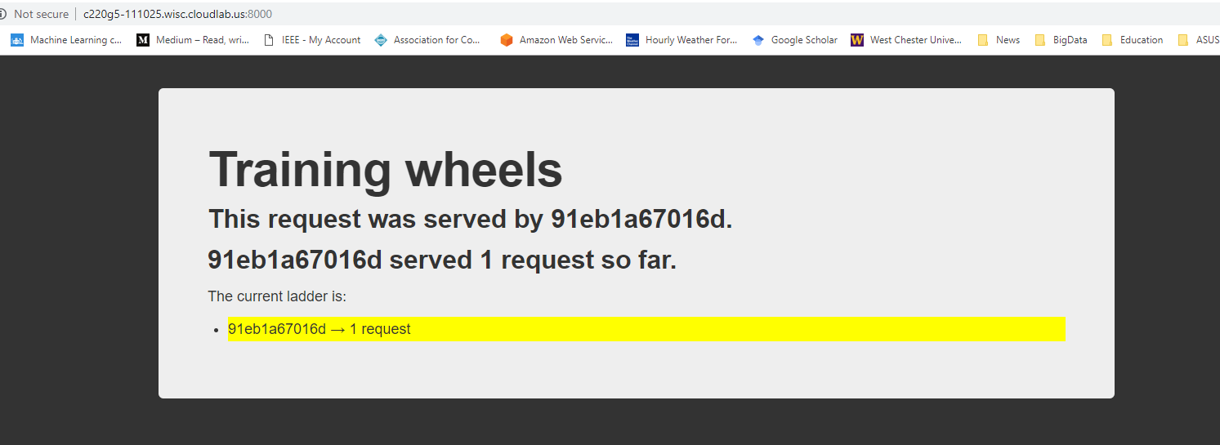
<your_cloudlab_hostname>:8000

Slide 71
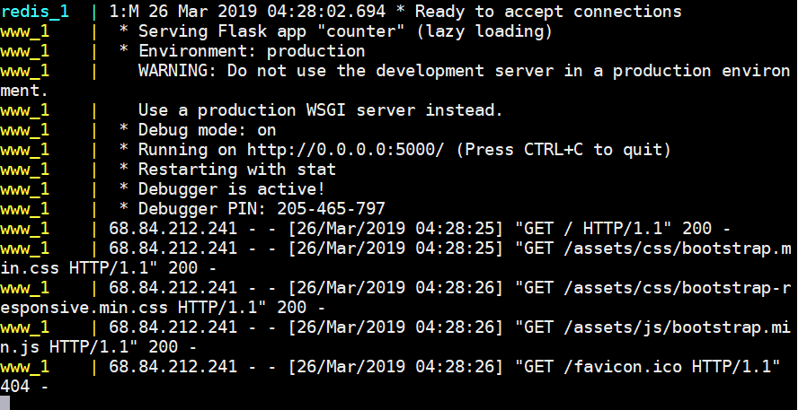

Slide 72
Stop containers
Hit Ctrl-C to stop the containers.

Slide 73
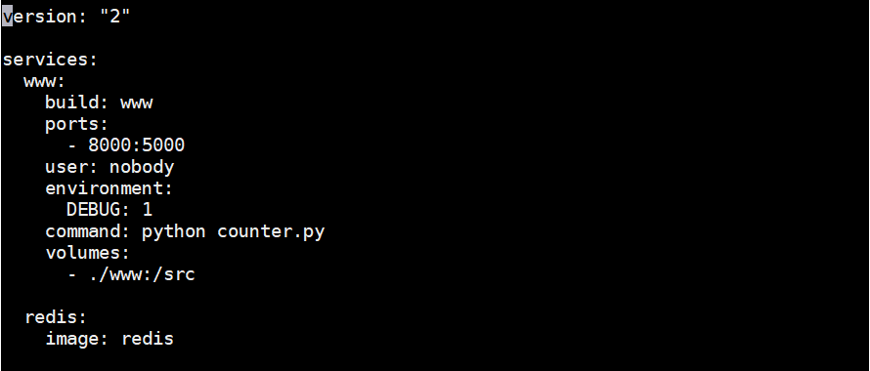
$ nano docker-compose.yml

Slide 74
Sections of a compose file
version is mandatory (“2” or later)
services is mandatory. A service is one or more replicas of the same image running as containers.
networks is optional and indicates to which networks containers should be connected. By default, containers will be connected on a private, per-compose-file network.
volumes is optional and can define volumes to be used and/or shared by the containers.

Slide 75
Compose file versions
Version 1 is legacy.
Version 2 has support for networks and volumes.
Version 3 has support for deployment options.

Slide 76
Containers in docker-compose.yml
Each service in the YAML file must container either build or image.
build indicates a path containing a Dockerfile.
image indicates an image name (local or on registry).
If both are specified, an image will be built from the build directory and named image
Other parameters are optional and typically what you would add to docker run
command = CMD
ports = -p
volumes = -v

Slide 77
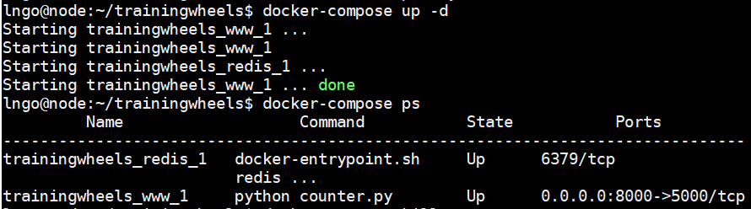
Starting containers in background and check status
$ docker-compose up -d
$ docker-compose ps

Slide 78
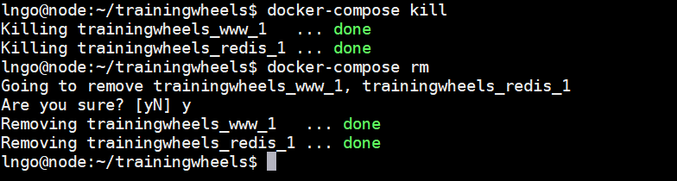
Cleaning up
$ docker-compose kill
$ docker-compose rm

